Slide 1
Intermittent Positive Pressure Ventilation Requirements
Based on
conversations with respiratory therapists
DoD COVID-19 Practice Management Guide - Health.mil
SOCOM Hack-a-Vent Vulcan Challenge requirements
FDA Emergency Use Authorization requirements for Ventilators https://www.fda.gov/emergency-preparedness-and-response/mcm-legal-regulatory-and-policy-framework/emergency-use-authorization

Slide 2
Operation Mode Requirements
ON TRACK - The ventilator system shall operate continuously without interruption for 24 hours (threshold), 5 days (objective). Endurance data for the USED Spectra breast pumps indicates >24 hours continuous operation for all 3 Spectra pumps. Expected pump life >1500 hrs.
MEET - The ventilator system shall provide a respiratory rate of 15-16+ breath/min - adjustable
MEET - Inhalation:Exhalation (I:E) ratio of 1:2 to 1:3 - adjustable
MEET - Delivered oxygen concentration of FiO₂: 40%-90+% - adjustable
MEET - Deliver peak end expiratory pressure (PEEP) of 12-20cmH2O - adjustable
ON TRACK - Deliver tidal volume of 350ml / breath. Current pumps deliver 180ml/breath. Our modifications use a second compressor to double that to 360ml/breath - NOT adjustable

Slide 3
Input Requirements
NEED TO TEST - Ventilator shall accept input air pressure: 50 ± 5 psi (in accordance with NFPA99 hospital standard – this is what’s available in the walls)
NEED TO TEST - Ventilator shall accept input O2 pressures between 50 ± 5 psi (in accordance with NFPA99 hospital standard – this is what’s available in the walls)
MEET - Ventilator system shall accept input power of 120V A/C.
MEET - Ventilator system power cord length ≥ 6 ft
MEET - System shall interface with standard 22mm medical tubing.

Slide 4
Output requirements
MEET, with 2 safety releases - Ventilator shall deliver intermittent positive patient lung pressure not to exceed a RT adjustable safety maximum of 20-30 cmH20. - adjustable
MEET - Ventilator system shall prevent any instance of delivered positive pressure exceeding 30 cmH20, and provide an audible and light alert if this condition is reached. - adjustable
MEET - Ventilator must use replaceable in-line backflow gas filters prevent patient exhalation gasses/droplets from entering the device, for any particles ≤ 0.3µm ± 0.05µm. (These filters may be acquired from a 3rd party.) This will maintain sanitization and therefore reusability of the devices themselves. All tubing or other equipment between this filter and the patient are assumed to be contaminated, and does not need to be reusable.

Slide 5
Other device requirements
UNKNOWN - All ventilator labels and displays in large ADA compliant font.
DO NOT MEET YET - Ventilator operating status must be clearly indicated at all times (OFF, Standard IPPV, Acute Emergency, and ERROR).
MEET but need to test - Ventilator shall continue normal operation temperature 40F – 104F, with 0 – 100% humidity.
MEET - Ventilator must continue operation during full external sanitization/sterilization using 70-100% ethanol spray and wipes.
MEET but need to test - Ventilator shall be operable by 1 person, with ≤ 2 hours of specific training.
IN WORK- Ventilator system training shall be delivered electronically.
MEET - All external interfaces to the ventilator system shall be clearly labeled on the ventilator, including any required tubing sizes, tubing or cable types, tolerances, and/or attachment procedures.
MEET but need more testing - Ventilator must survive and continue operating normally after falls of ≥ 4 feet onto concrete floor.
MEET - Ventilator weight ≤ 30 lbs. The system can be installed on a standard rolling hospital IV pole.

Slide 6
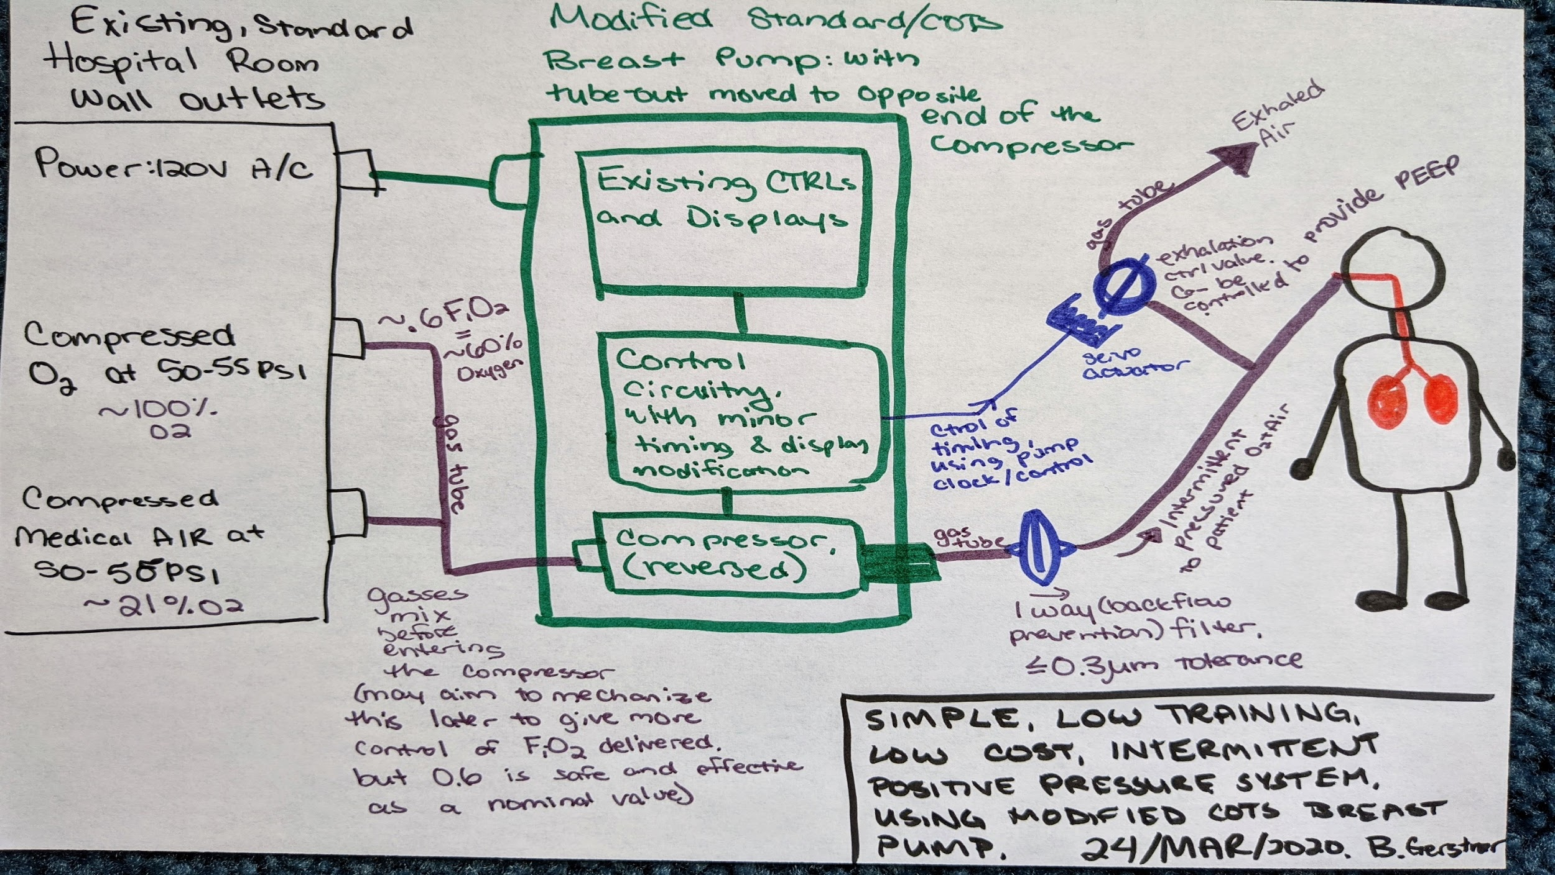
Initial concept

Slide 7
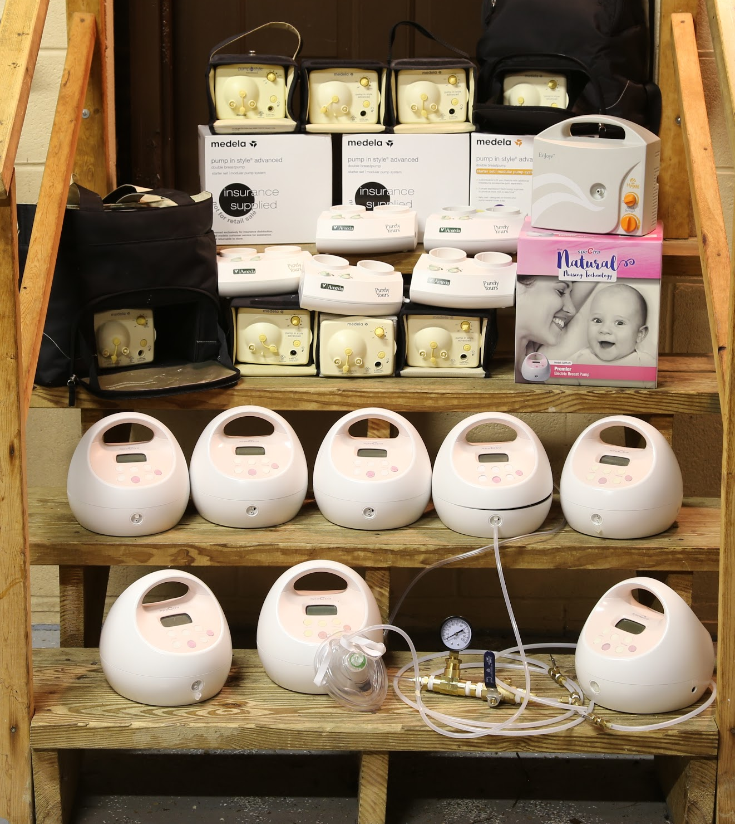
Community donations within first 24 hrs

